Slide 1
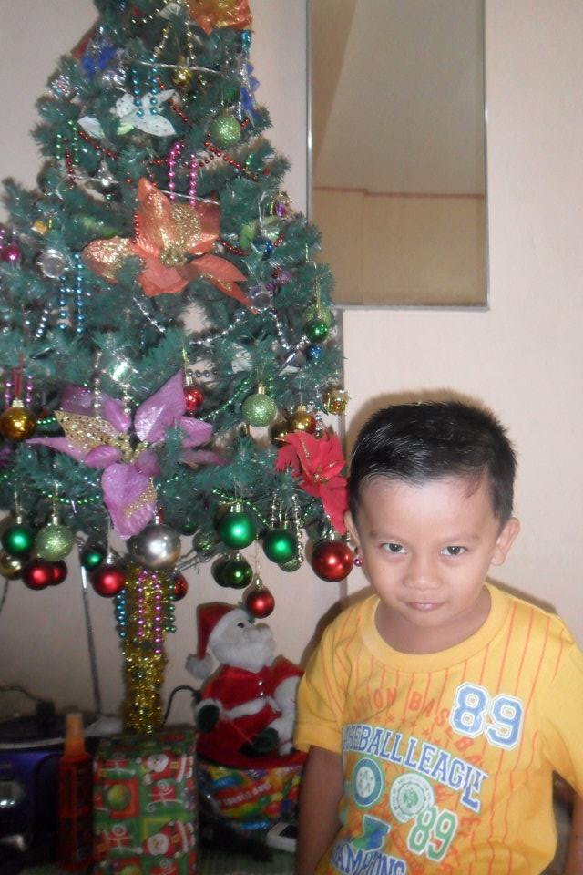
AXEL`S
TIMELINE
> 2006
> XMAS EVE 2016
> BAPTISM 2007
> OUTING 2019
> XMAS EVE 2012
> ELEM. 2019
> KINDER 2012
> FIELD TRIP 2023
> NEW YEAR`s EVE 2014
> HIGHSCHOOL 2023

Slide 2
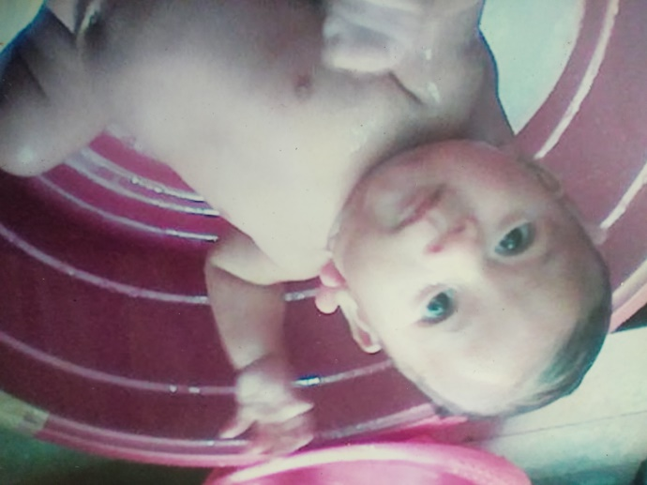

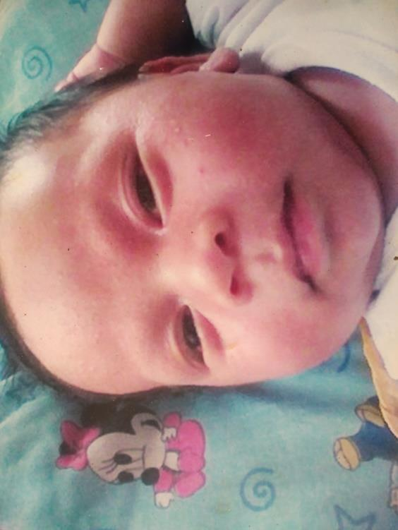
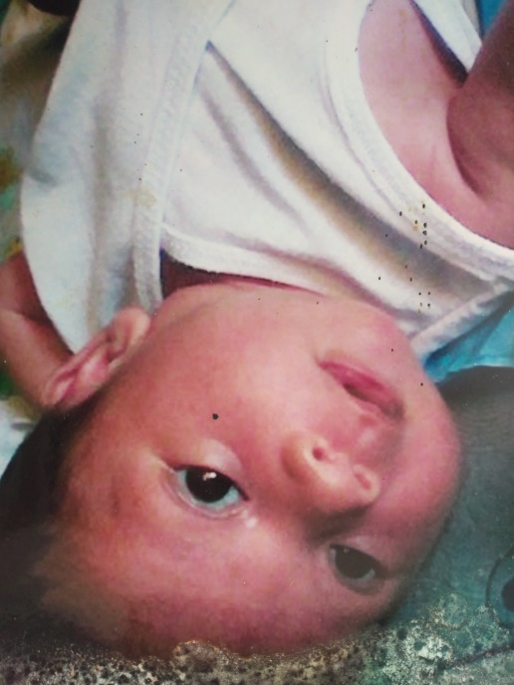
AXEL`S
TIMELINE
THESE PICTURES WAS TAKEN 17 YEARS AGO
My birth date is on November 30, 2006.

Slide 3
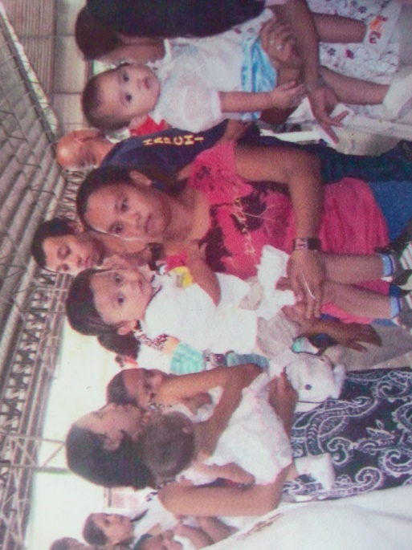

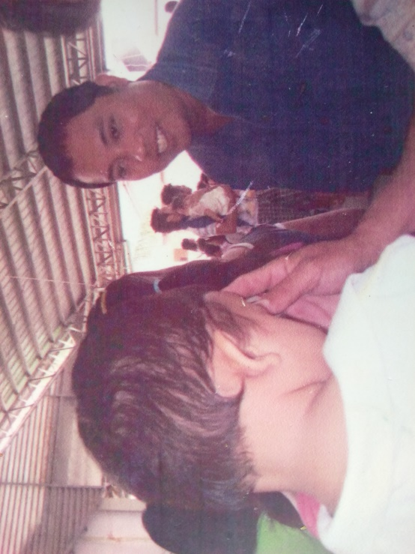
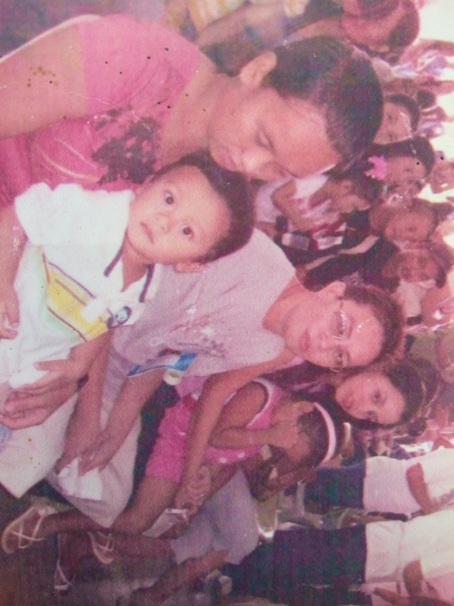
I WAS BAPTIZED IN PARKLANE DASMARINAS CAVITE
This was December 28, 2007.

Slide 4
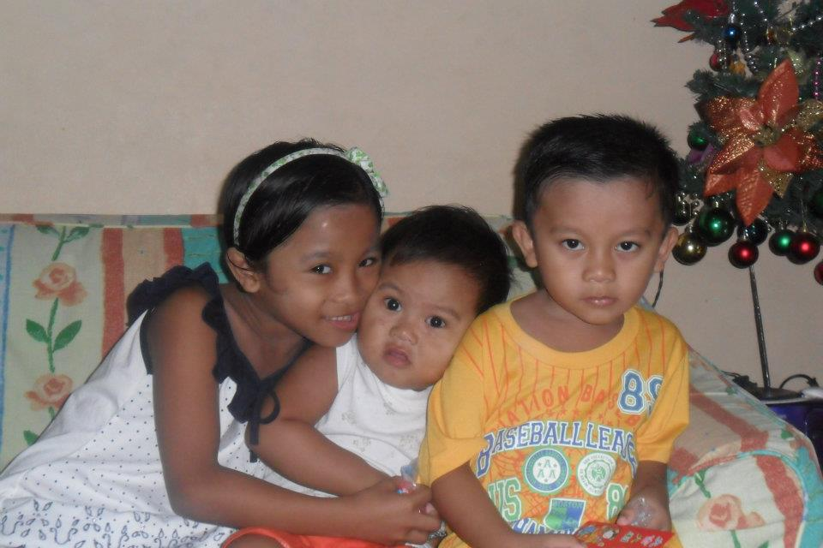

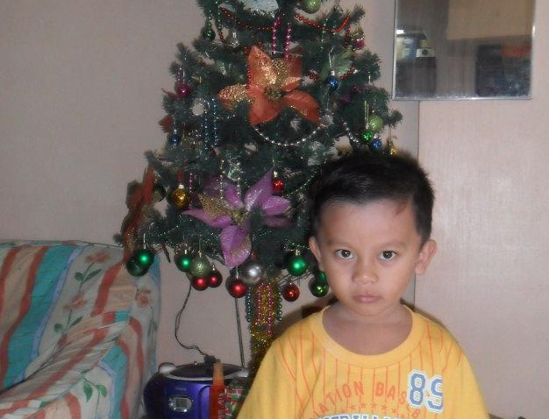
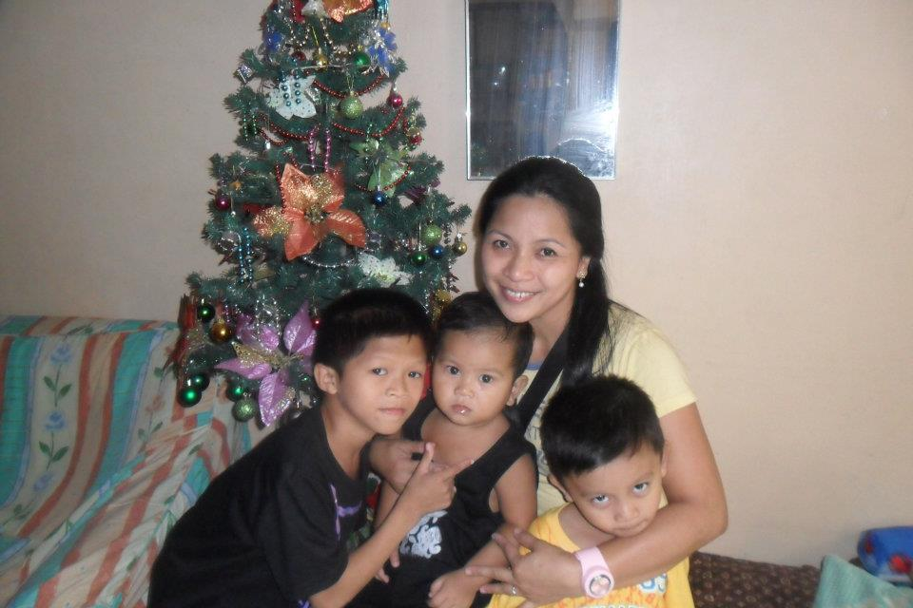
CHRISTMAS EVE
2012, PARKLANE
DASMA, CAVITE
On this Christmas, my mom and dad visited me and my sister in our tita`s house.

Slide 5

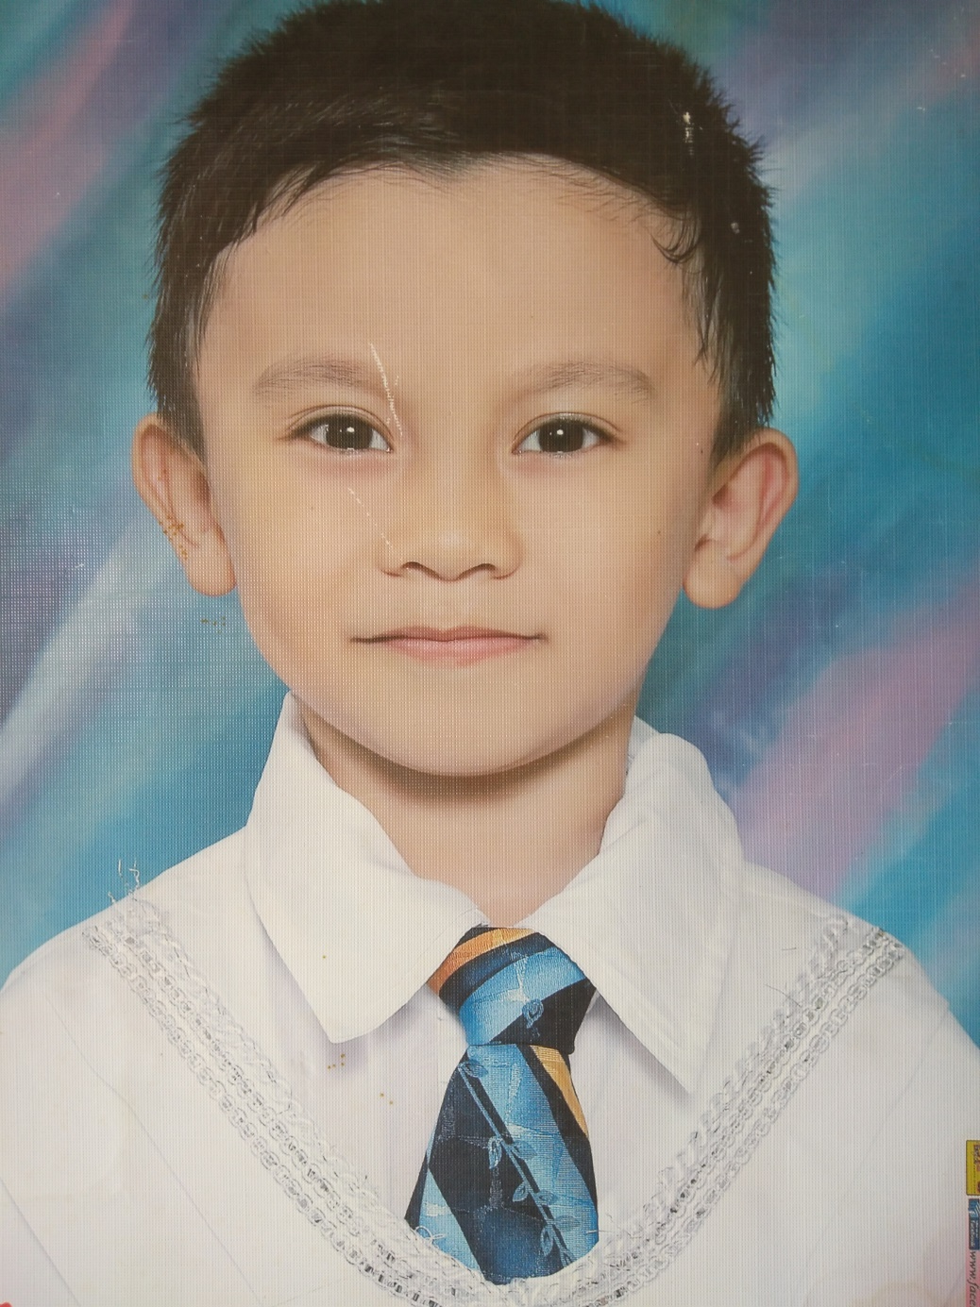
I GRADUATED KINDERGARTEN IN PARKLANE ELEMENTARY SCHOOL
2012, I was the top 3 here.

Slide 6

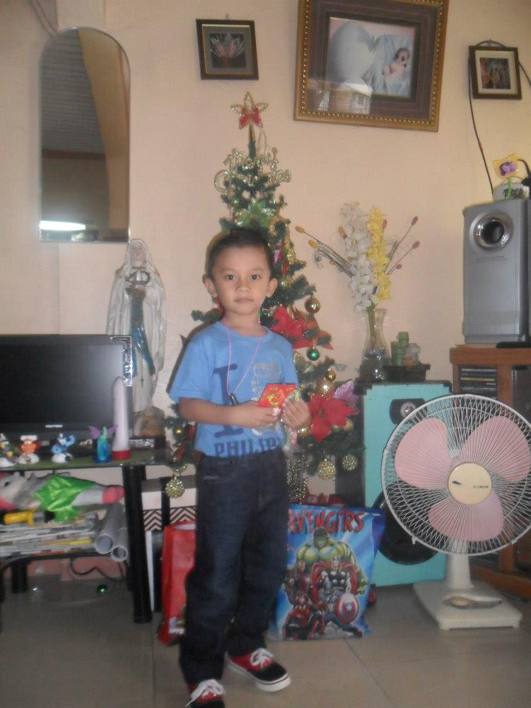
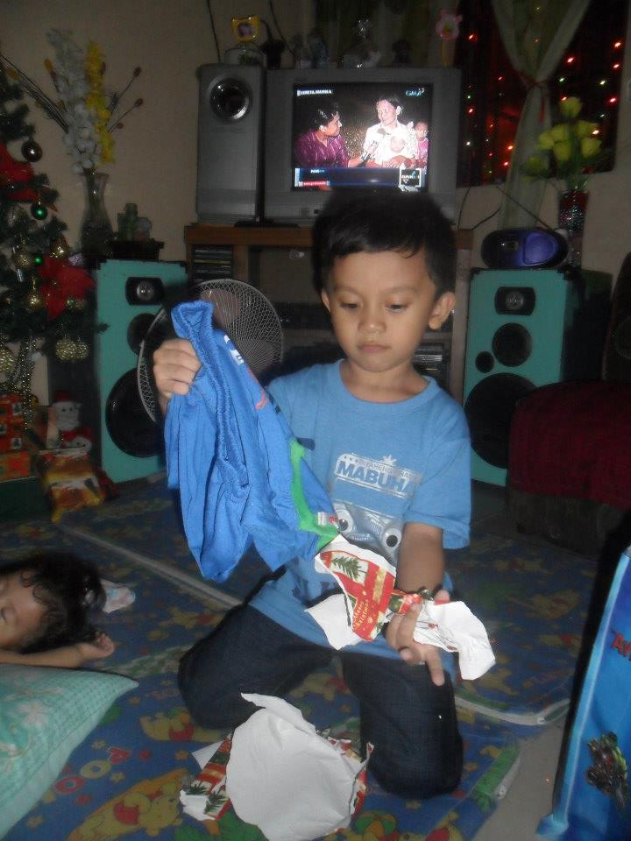
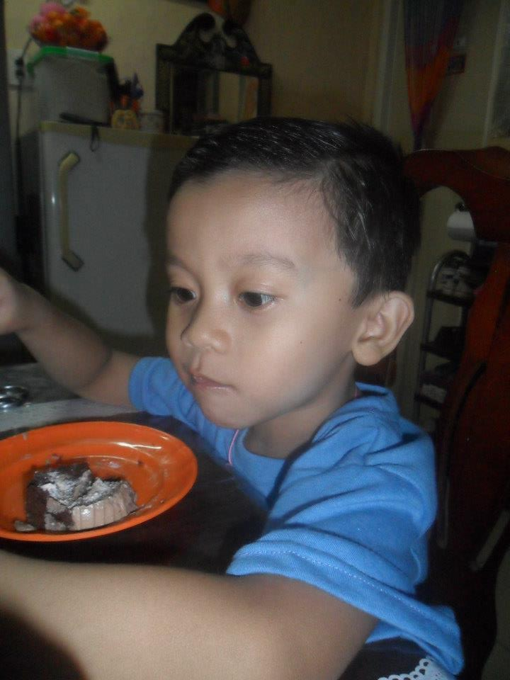
NEW YEAR`S EVE 2014
I got a shirt and a pair of shoes from my tita.

Slide 7

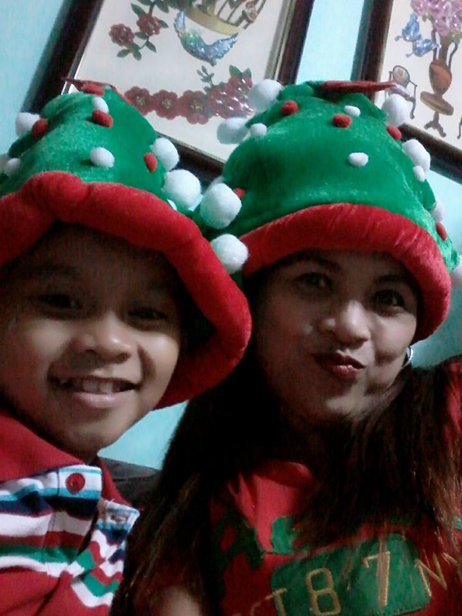
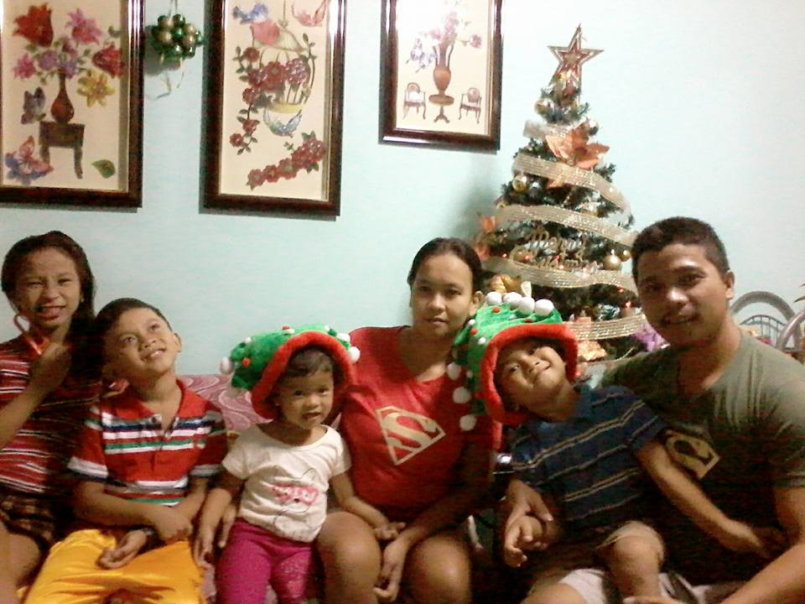
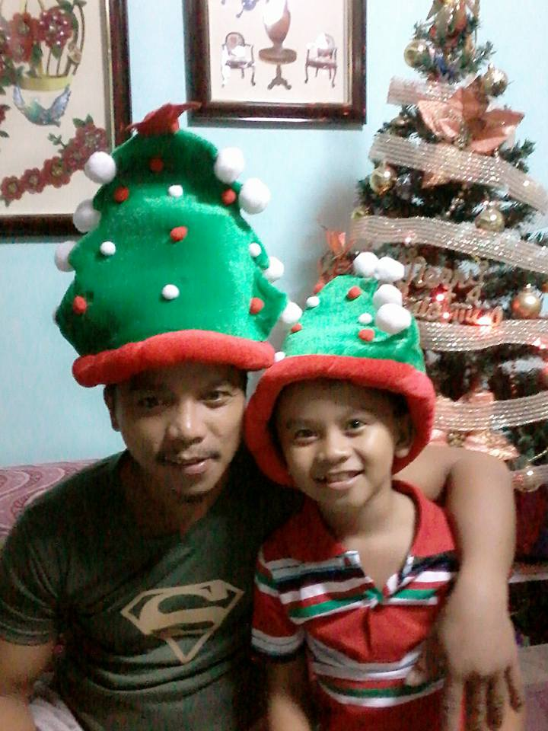
CHRISTMAS EVE 2016, THE YEAR WE MOVED TO IMUS, CAVITE
My lola gave me a lego watch and my tita gave me a towel.

Slide 8

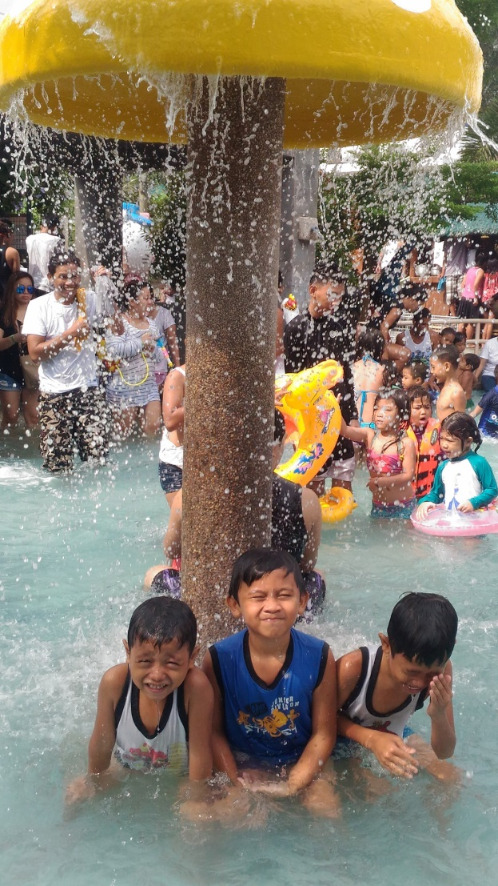
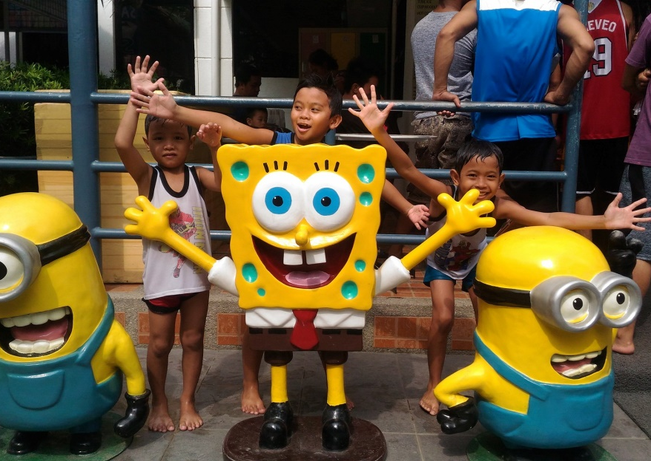
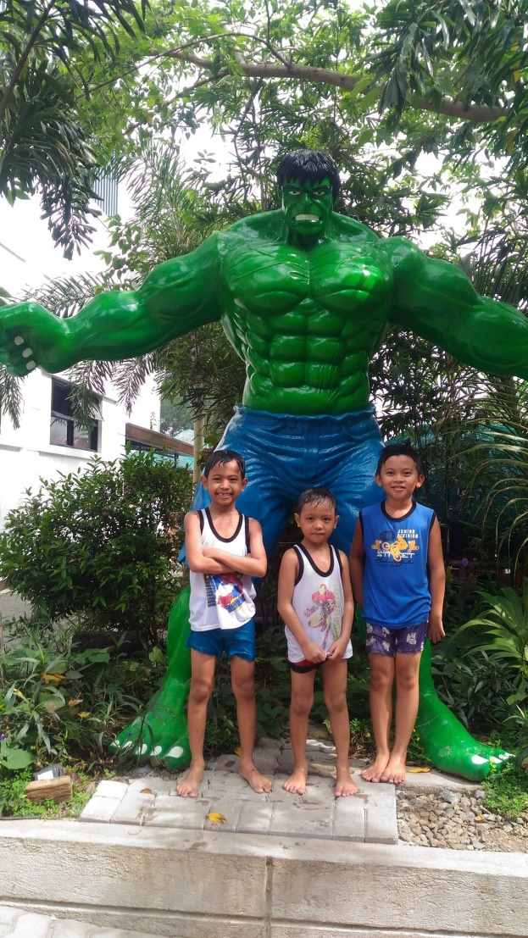
WE HAD AN OUTING WITH MY COUSINS,
THIS WAS 2019
This was in Saniya Resort, Dasma, Cavite.

Slide 9
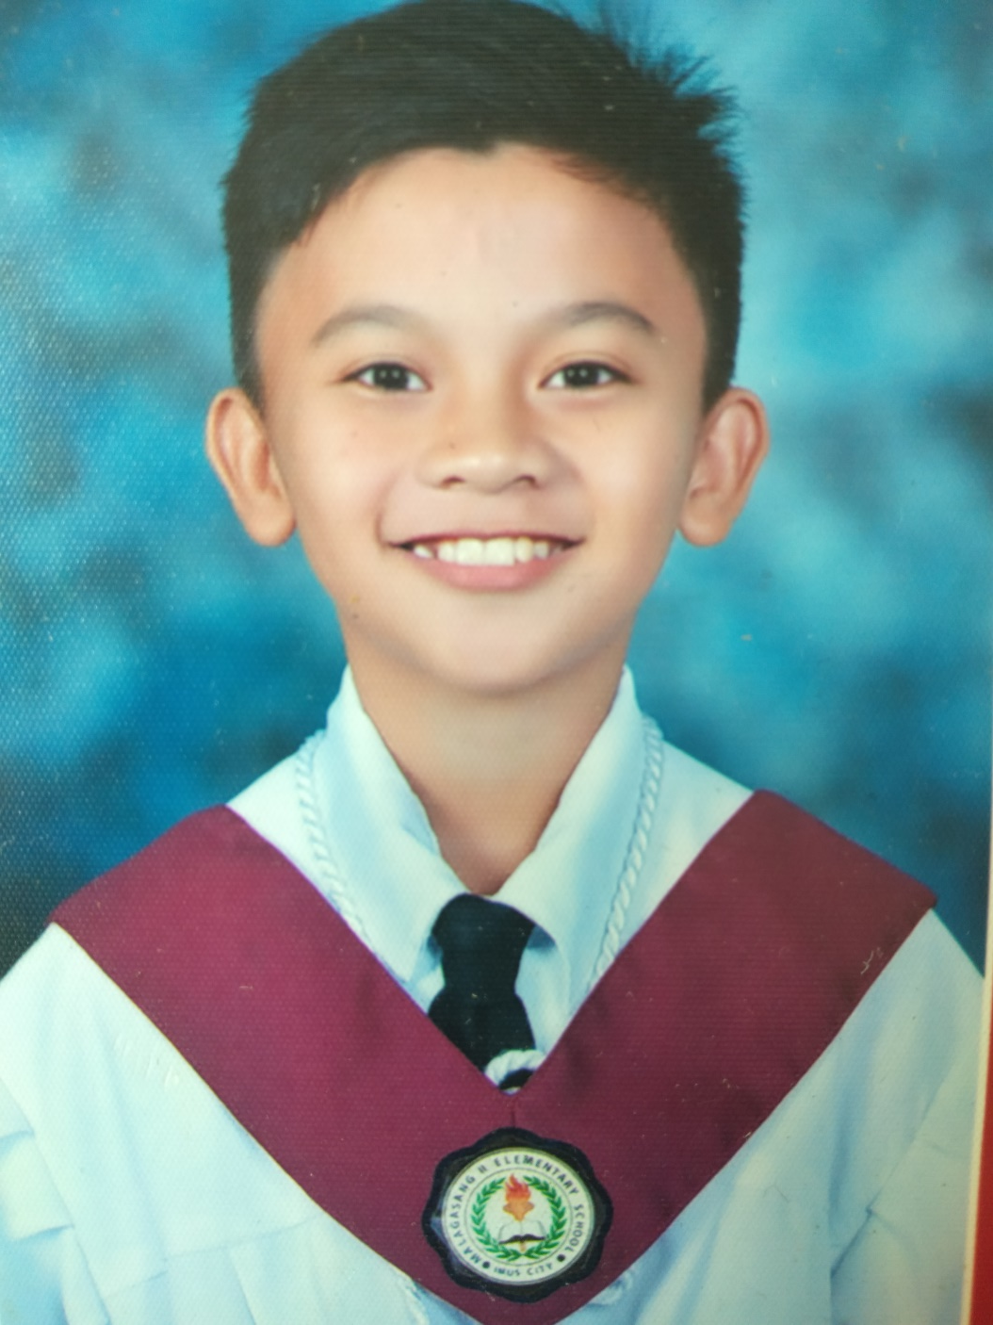
I GRADUATED ELEMENRARY IN MALAGASANG II ELEMENTARY SCHOOL
2019, I`ve got an honor here for having a general average of 91.

Slide 10

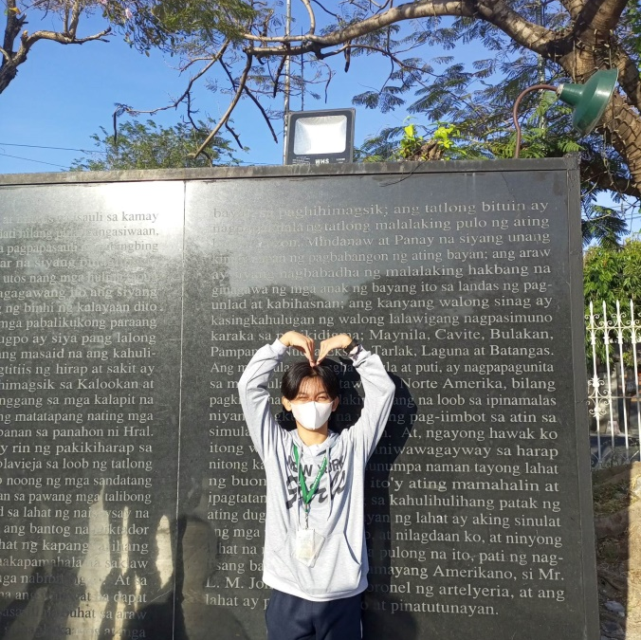
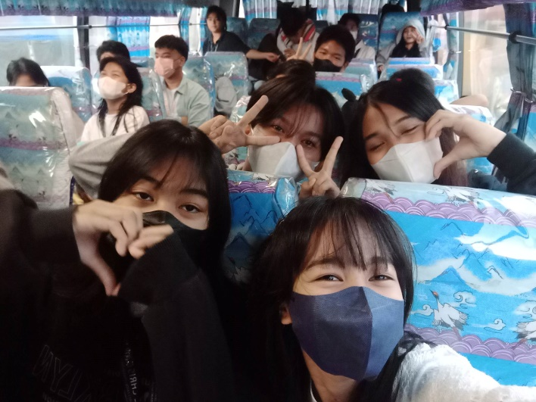
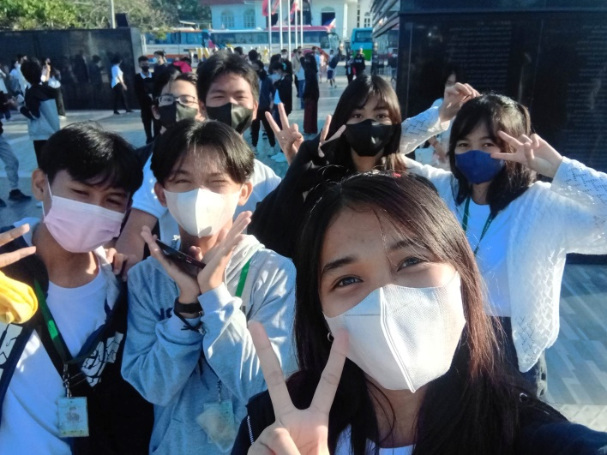
FIELD TRIP 2023, GRADE 10
We went to Emilio Aguinaldo Shrine, Gardenia Factory, Rizal Shrine, and Enchanted Kingdom.

Slide 11
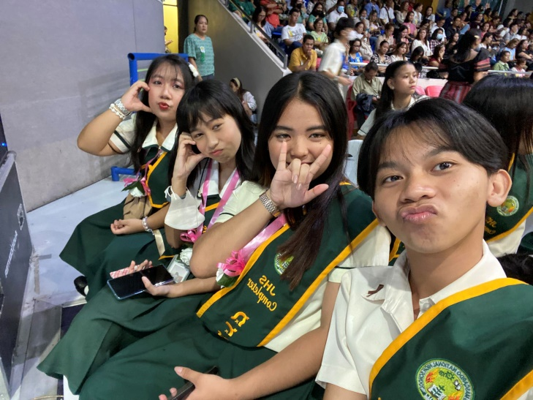
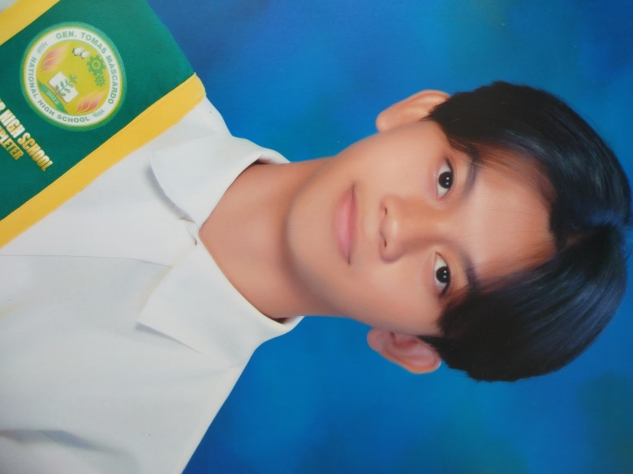
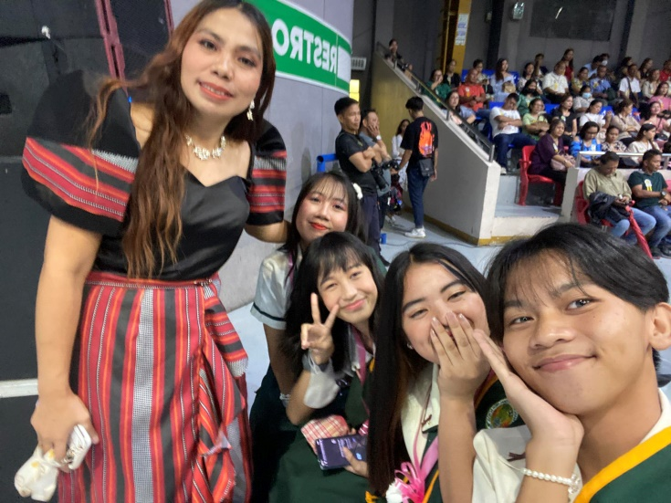
I GRADUATED HIGHSCHOOL IN GEN. TOMAS MASCARDO NATIONAL SCHOOL
2023, I`ve got an honor here for having a general average of 93. The moving up takes place in Imus Complex.
BACK TO TIMELINE !!

